Slide 1
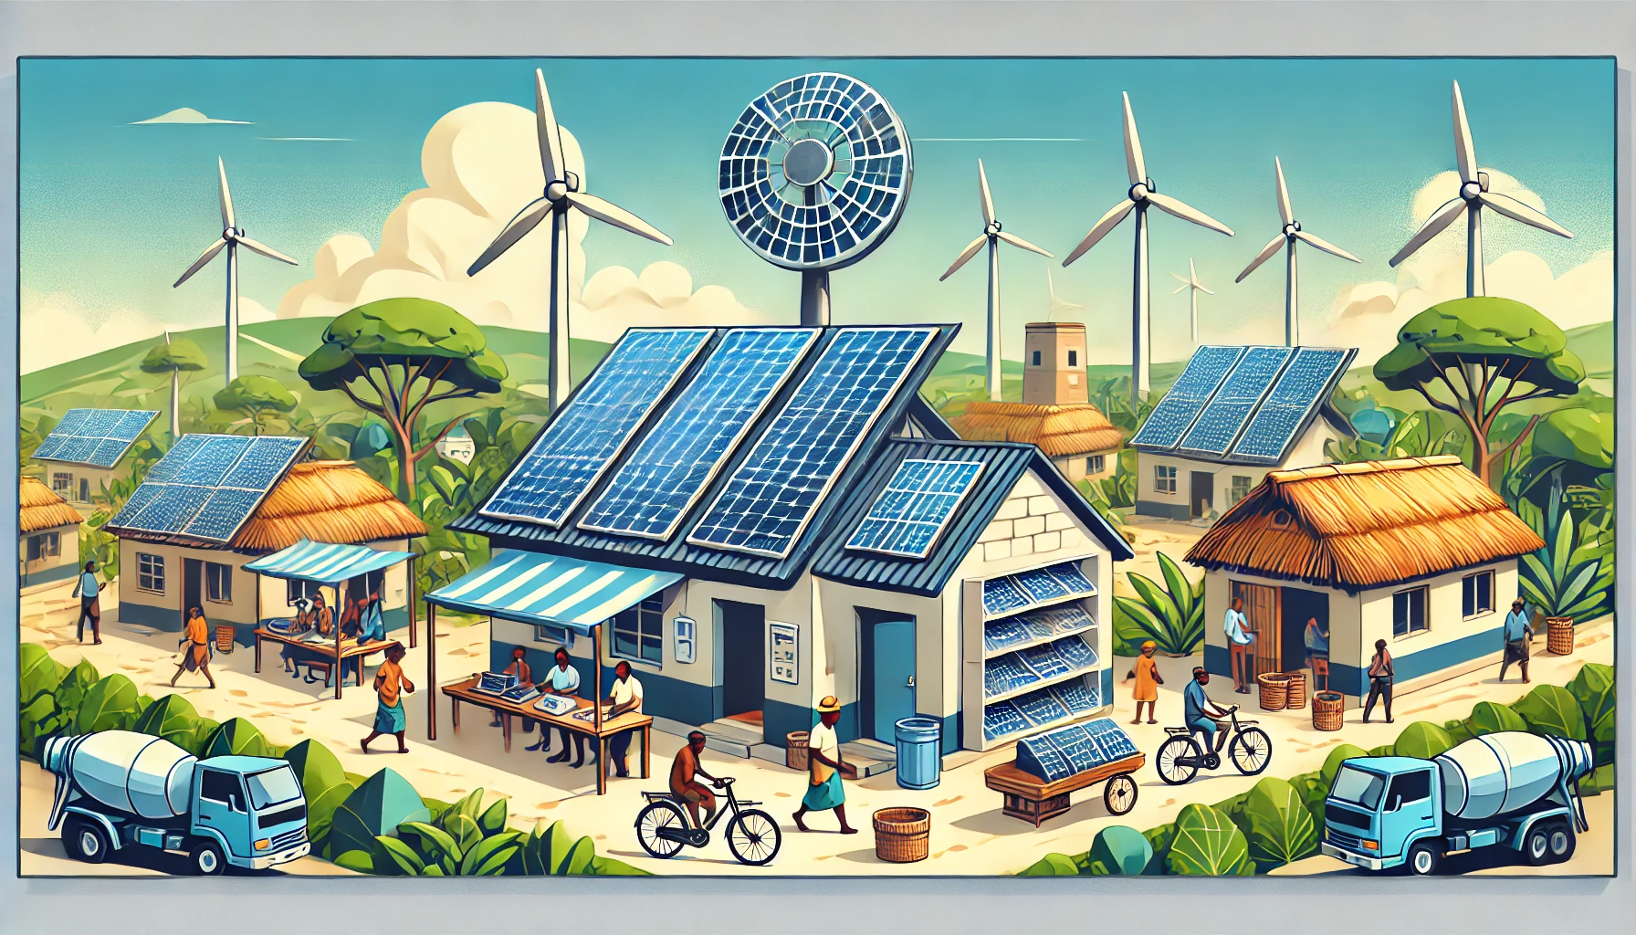






Webinar 3: Mobilising PUE technologies and finance to catalyse mini-grid development

Slide 2
Overview of webinar
Welcome
Overview of the agenda
Introduction to GGEEA and WP2 work to develop mini grid data set
Energy Alliance - the case of Mobilising public and private finances for large scale solar powered irrigation in Ethiopia.
EnerGrow - Unlocking financing for small and medium-sized enterprises.
RMI - Identification of PUE activities, delivery models, and a business model framework: The appliance of financing options.
Q&A
Closing & final remarks

Slide 3
Introduction to GGEEA and WP2 work to develop mini grid data set
CLUB-ER

Slide 4
Implementation team aims
to accelerate the deployment of mini-grid in Africa
GGE-EA project aims:
To build the capacity of rural electrification officials / players
To improve understanding of challenges / opportunities for mini grid deployment
To support the development of new bankable mini grid projects
Work Packages: Delivering peer-to-peer learning opportunities training
Working on the reasons of failure and success of minigrid project
Facilitating public-private sector engagement to support collaboration
Capture and disseminate lessons learned from GGE-EA project
Activities: Online course
Webinar
Workshop and roundtable discussion with all players
Knowledge product on key lessons

Slide 5

Forum for discussions amongst all African stakeholders in charge of developing and implementing RE, increasing access to modern, affordable, and reliable electricity services in rural areas.
Supports national / regional responses to climate change through policy and knowledge interventions, partnerships and deep collaboration.
brings together representatives from governments, civil society and the private sector working to advance low emission development strategies across the continent.

Slide 6
Mobilising public and private finances for large scale solar powered irrigation in Ethiopia
Energy Alliance

Slide 7
Unlocking financing for small and medium-sized enterprises
EnerGrow

Slide 8
Insights on PUE delivery models, and a business model framework: The appliance of financing options work
RMI

Slide 9
Q&A

Slide 10
Final remarks and closing

